Slide 1
Word Meaning
Chapter 11

Slide 2
Memory Types
Episodic memory – memory for events and episodes, diary
Semantic memory – general fact based knowledge, encyclopedia
Lexicon – our mental dictionary

Slide 3
Categories
Category – group or organization of related things
Concept – a member of a category (i.e. the thing)

Slide 4
Categories
Category formation
Based on the way we perceive the world
Cognitive economy – memory is organized to be efficient, avoiding lots of duplication

Slide 5
Categories
Superordinate – more abstract (animal, mammal)
Basic level names – dog
Subordinate – specific category member (collie, beagle)

Slide 6
Categories
Associations arise from words regularly occurring together
Semantics shared contexts and higher level relations (features)

Slide 7
Classic Semantics
Definitions:
Denotation – its core essential meaning
Connation – all secondary meanings, emotional or evaluative associations

Slide 8
Classic Semantics
Theories
Referential theory – words mean what they refer to
Justice?
Intension – abstract specification that determines how a concept is related in meaning to other words

Slide 9
Classic Semantics
Theories
Extension – what the word stands for in the world
Model theoretic semantics – (truth theoretic semantics) – logical models of complex meaning

Slide 10
Semantic Networks
Semantic network – concepts are linked because of their frequency (association) but also the links between concepts have meaning.

Slide 11
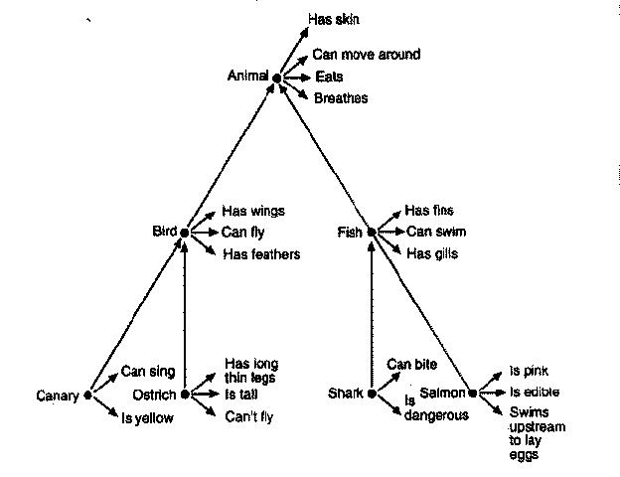
Semantic Networks
Collins
and
Quillian

Slide 12
Semantic Networks
Collins and Quillian – Specs
Developed to translate between languages
Natural categories – like animals, trees
Hierarchical Network – like biology arrangement
Link types – ISA, HASA

Slide 13
Semantic Networks
Collins and Quillian
Sentence verification task
A robin is a bird.
A robin has lungs.

Slide 14
Semantic Networks
Collins and Quillian
The sentence verification task shows you the response times > which lets you see the hierarchical network.

Slide 15
Semantic Networks
Collins and Quillian – Problems
Not all information can be represented that way
Conjoint frequency – how frequently two words co-occur together
This model doesn’t cover association versus semantic distance

Slide 16
Semantic Networks
Collins and Quillian – Problems
Relatedness effect – don’t reject all untrue statements equally slowly
A pine is a church is slower than a pine is a flower.
Prototypicality effect – we are faster for items that are more typical of a category
A robin is a bird is faster than a penguin is a bird

Slide 17
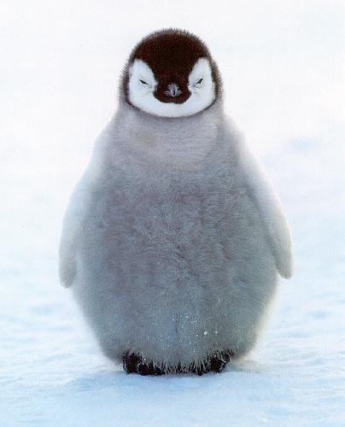
Semantic Networks
Collins and Quillian – Problems
We are faster to categorize items that match more features…should be the same.

Slide 18
Semantic Networks
Collins and Loftus
Spreading activation model – structure become more complex, links between nodes (circles) varied in strength

Slide 19
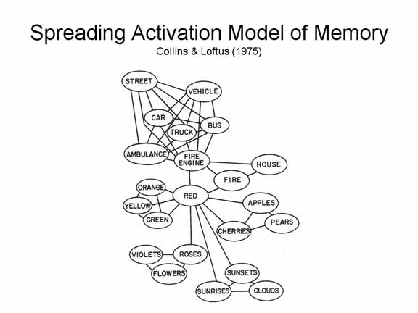

Slide 20
Semantic Networks
Collins and Loftus
Structure is not hierarchical
Connectionist model – things are linked together and priming is based on spreading activation to other concepts.

Slide 21
Semantic Features
Decompositional Theories
Semantic features – smaller units of meaning (markers, attributes)

Slide 22
Semantic Features
Break down words into features
Work well for simple domains
Semantic primitives – represent the meanings of words as combinations of as few features as possible

Slide 23
Semantic Features
Katz & Fodor
Sentence meaning can be built from combining individual word meanings

Slide 24
Semantic Features
Katz & Fodor
1st: semantic decomposition – breaking down the words into features
2nd: Selection restraints – combination of features based on restraints
Kick – you expect to kick something like ball

Slide 25
Semantic Features
Feature list theory
Our semantic knowledge is based around a list of features that make up that concept
Defining features – essential to the meaning of words
Characteristic features – usually true of category members, but not always

Slide 26
Semantic Features
Feature list theory – sentence verification task
First overall feature similarity is computed
Lot of overlap = say true fast
Low overlap = say false fast
Middle levels = go to stage two

Slide 27
Semantic Features
Feature list theory – sentence verification task
Second stage we consider only defining features

Slide 28
Semantic Features
Feature list theory
What are the defining features?
People do not agree.

Slide 29
Semantic Features
Probabilistic feature model – Thresholds!
Core description - essential defining features of the concept
Identification procedures used to identify instances of a category
Features are weighted by saliency and probability

Slide 30
Semantic Features
Evaluation:
Can’t tell the difference between network and feature models
They are economical
Defining features aren’t all the same

Slide 31
Semantic Features
Evaluation:
Inter correlated features – relationship between features not captured
Procedural invariance – same question gives you different answers – it shouldn’t with these theories
Is a robin a bird?
Is a bird a robin?

Slide 32
Family Resemblance
Prototype model
Prototype – an abstraction that is the best example of a category
These are said to be ideal
May be a combination of different examples

Slide 33
Family Resemblance
Prototype model
You decide that something is in the category by comparing to the prototype
Schema – a means for organizing knowledge

Slide 34
Family Resemblance
Prototype model – better than feature theory
Sentence verification faster for prototypical members
Features are said to be schema fillers

Slide 35
Family Resemblance
Prototype model
Basic levels – default level of categorization at which we think
Economizes
Gives us most information

Slide 36
Family Resemblance
Prototype model – basic levels
Most salient
How we name things
Can list attributes at this level
Children learn these first

Slide 37
Family Resemblance
Prototype model – problems
What is the prototype for truth?
Women fire and dangerous things category in Dyirbal
Similarity tasks are circular

Slide 38
Family Resemblance
Instance theories
Exemplar theory – we compare information to a specific stored example
Same as prototype, but process is different
Just seems to be the way we think…

Slide 39
Family Resemblance
Instance theories
Instantiation principle – category includes detailed information about the range of instances
Not quite so economic

Slide 40
Family Resemblance
Theory theories
People represent categories as miniature theories that describe facts about those categories and how they relate
Sort of like a dictionary
Children do something like this

Slide 41
To end!
Network theories (connectionism)
Feature list theory / probabilistic theory
Prototype theory
Instance/Exemplar theory
Theory theory

